Slide 1
Sustainability Failures in Rural Telecenters
Challenges from the SARI Project
Amit Maniyar
(2007CS10154)
Ankit Narang
(2007CS10156)

Slide 2
Objective
To examine the factors affecting sustainability of an ICT4D project in rural India, namely ‘Sustainable Access in Rural India (SARI) Project’
To examine the reasons for sustainability failure of kiosks run by private entrepreneurs
To understand how best to enhance the efficiency and effectiveness of such projects and to realize their long-term sustainability.

Slide 3
The SARI Project
Started in November 2001
A collaborative venture of several organizations:
Harvard, MIT, IIT Madras, McKinsey
Kiosks: Fees levied for various services
36 privately owned kiosks (Chirag kiosks)
42 kiosks operated by Dhan Foundation
By May 2005, 32 of the 36 Chirag kiosks had ceased to function
Most of the Dhan kiosks were still operational

Slide 4
The SARI Project (Contd.)
Project partners:
Initial support: ICICI; Ray Stata
Implementing partner: n-Logue Communication
E-governance: local government & administration
Other collaborations (e.g. Arvind Eye Hospital)
Institutional Framework:
Laid out through the executive order of TN Govt.
E-governance services: Madurai district collector
Business Model:
A wide gamut of services
User fees for services
Voice services included (Never implemented)

Slide 5
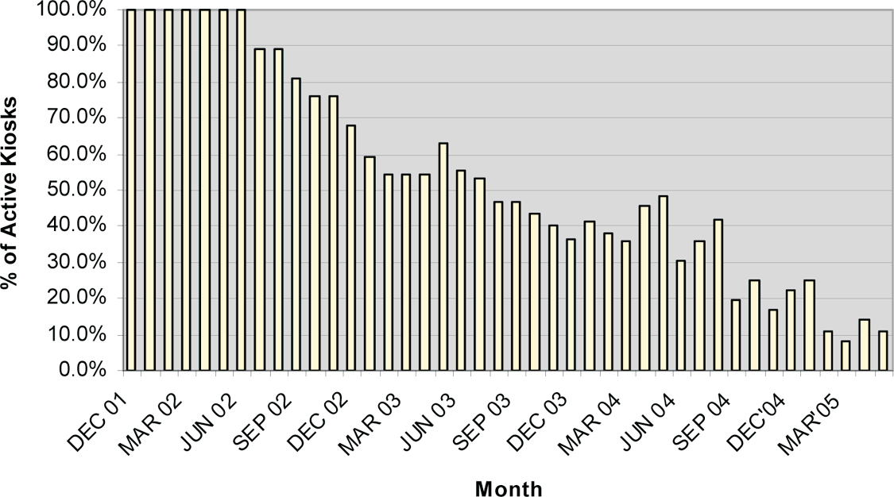
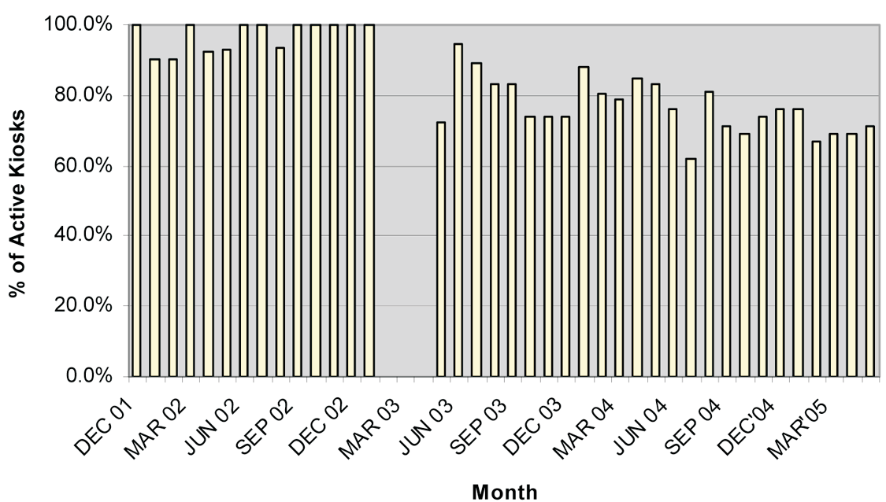
Research Methods
Priamary variable: duration fro which each telekiosk was “active”
Percentage of active Chirag kiosks in Melur, relative to those Percentage of active Dhan kiosks in Melur, relative to those
opened during that month opened by that month

Slide 6
Possible Factors determining “Kiosk Life”
institutional, operational, and technical support provided by n-Logue
Initial functioning time
Different owner and operator
Villager’s liking of the facility
Owner’s opinion:
No voice telephony
Poor support from n-Logue
Lack of financial returns
Bad Internet Connectivity

Slide 7
Significant factors
Lack of support from n-Logue
Different owner and operator
Better coordination for service delivery
Prior computer training of the owner/operator
Lack of support from elected representatives
Disinterest of politicians
Transfers of administrators
Lack of adequate technical support
High technolog maintenance costs
Failure of institutional linkages
No incentive for the institutions
Lack of new content

Slide 8
Differential Performance of Dhan and Chirag Kiosks
Dhan kiosks supported financially by Dhan Foundation
No external financial support for Chirag kiosks
Assured operator wages in Dhan kiosks
Institutional support for developing new content
Subsidies for technological and operational expenses in Dhan kiosks, whereas no such option for private kiosks owners

Slide 9
Critical Failure factors (1999)
Heeks and Bhatnagar factors:
information, technical, people, management, process, culture, structure, strategy, politics, environment
Lack of institutional support: Management, cultural, and structural factors
Lack of technical support: Technical factor
Lack of institutional partnerships: Management, process, and strategic factors
Lack of new and relevant content: Information factors

Slide 10
Critical Analysis
Strengths:
A comprehensive study taking multiple factors into account
Inclusion of qualitative & quantitative factors
Concrete statistical calculations to arrive at conclusions
Explaining failure factors in agreement with prior works on failure models

Slide 11
Critical Analysis
Weaknesses:
Firstly, a long and repetitive paper
User feedback is missing
No latent factors analysed

Slide 12
Community Internet Access in Rural Areas: Solving the Economic Sustainability Puzzle

Slide 13
ICTs for rural areas
Conventional assumption:
Need for subsidies
Financial loss inevitable
Sustainability requirements:
Economic viability:
Costs
Capacity
Revenue
Networks
Business models
Policy
Shared resources: Telecentres/Telekiosks

Slide 14
Keeping Costs Low
Capital cost reduction
New cheaper hardware
Wireless Network
Recurrent cost reduction
Telephone & Internet access technologies separating voice & data (e.g. corDECT)
Power costs:
Energy efficient devices (e.g. Pengachu)
Alternative power sources (e.g. PV)

Slide 15
Generating Revenue
Fee-for-services (e.g. e-commerce, education, entertainment)
Remote Services/back office activities
Aggregation of services & users

Slide 16
Benefits of Scope & Scale
Value of internet grows with the square of number of users (Metcalfe effect)
Aggregation of rural networks
Context-appropriate business models

Slide 17
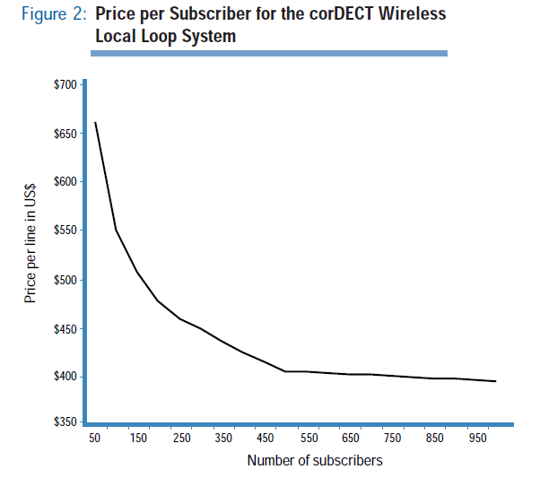

Slide 18
Benefits of Scope & Scale
Creation of Rural Service Providers (RSP)
Model similar to cable operators
Flat cost structure
Understanding of local market
Adding Telecenters to existing businesses
E.g. off-hour use of labs to generate revenue
Adding businesses to Telecenters
E.g. Computer repair, web design etc.

Slide 19
Policies to support rural access
Increasing competition between providers
Removing regulatory barriers:
Universal service & access requirement
Cash Deposit requirement
Wireless spectrum allocation
Incentives to support universal access
E.g. In Bolivia no fee licenses were offered in exchange for commitment to rural service & education

Slide 20
Policies to support rural access
Substituting dial-up connection
Use of VOIP to promote competition
Different metric for spectrum allocation

Slide 21
Building Local Capacity
Basic management & accounting skills required
Outreach efforts by individuals, non-profits & public organizations needed
Red Científica Peruana offers training sessions for telecenter operators on weekly basis

Slide 22
Critical Analysis
Strengths
RSP model to make community internet access economically sustainable
Remote services as source of revenue
Generating employment/businesses by use of telecenters
Aggregation of networks & thus exploiting economies of scale

Slide 23
Critical Analysis
Weaknesses
Elocution of the obvious
Lack of concrete solutions
Lack of supporting evidences

